Slide 1
Conditional Neural Process for Uncertainty Quantification
Prof. Souvik Chakraborty
Aditya Agrawal (2021AM10198)
Swapnil Kashyap (2021AM10782)

Slide 2
Conditional Neural Process
CNPs combine neural networks with features inspired by Gaussian Processes to define conditional distributions over functions based on observed data.
The model's dependency on observations is parameterized by a neural network that remains invariant under input permutations, ensuring consistent predictions regardless of input order.
CNPs are designed to scale efficiently at test time with a complexity of O(n + m), where n and m represent the number of observations and targets, respectively.
The basic CNP architecture involves embedding each observation, aggregating these embeddings into a fixed-dimensional representation using a symmetric aggregator, and conditioning the function on this aggregate embedding.
This training method aims to enhance the model's performance across various scenarios, accommodating different ratios of observations to targets (n<<m or n>>m).

Slide 3
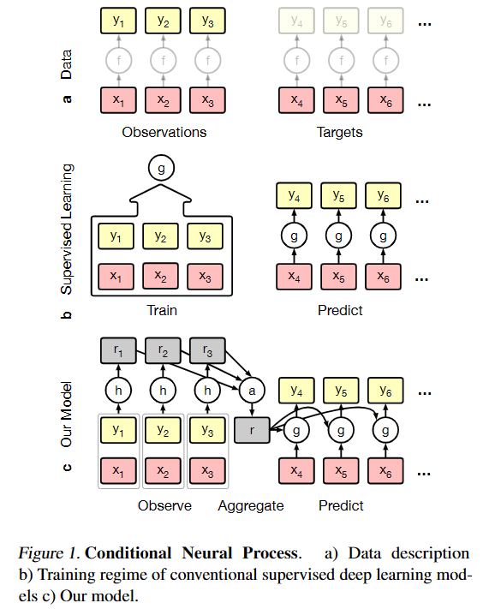
Schematic Representation

Slide 4
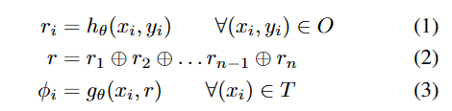
Mathematical Formulation of CNPs
Conditional Stochastic Process:
A CNP, denoted as Q_{θ}, defines distributions over functions f(x) for inputs x ∈ T based on a set of observations O.
Q_{θ} is a conditional stochastic process with parameters θ, invariant to permutations of both O and T.
Architecture:
CNPs condition on observations O through embeddings of fixed dimensionality.
The architecture involves neural networks h_{θ} and g_{θ} to compute embeddings and parameters φ_{i} for conditional predictions.
The architecture ensures permutation invariance and scales with complexity O(n + m) for conditional prediction tasks.
Task-specific Parametrization:
For regression tasks, φ_{i} parametrizes the mean and variance of a Gaussian distribution for each xi ∈ T.
In classification tasks, φ_{i} parametrizes the logits of class probabilities for a categorical distribution over classes.
The mean operation is typically used for aggregating embeddings in regression tasks.

Slide 5

Training of CNPs
Training Approach:
CNPs are trained by predicting observations O based on a randomly chosen subset of O, providing insight into the uncertainty in the distribution P given the observations.
The model conditions on a subset O_{N} of the observations O, comprising the first N elements of O, and minimizes the negative conditional log probability to learn the parameters θ.
Summary of CNPs:
CNPs are conditional distributions over functions trained to model empirical conditional distributions of functions f ∼ P.
They exhibit permutation invariance in both observations (O) and targets (T).
CNPs are scalable, with a time complexity of O(n + m) for making m predictions with n observations.
Model Flexibility:
The model can be customized for specific requirements, such as adapting the implementation of the encoder h based on the data type.

Slide 6
Why CNPs over DNNs and GPs
Advantages over traditional Neural Networks:
CNPs leverage empirical data instead of explicit priors, allowing for capturing complex patterns and dependencies effectively. This is not possible in the NNs where the extent of prior knowledge be used later is relatively limited, and learning cannot be shared between different tasks.
NNs typically require large datasets for efficient training whereas CNPs can be modelled with permutations of varying number of observations and targets.
Advantages over Gaussian Processes:
CNPs have a lower computational complexity of O(n + m) at test time compared to GPs, which can be computationally expensive for large datasets.
CNPs encapsulate high-level statistics of a family of functions, making them more general and reusable for multiple tasks compared to GPs, which are limited by their predefined kernel functions.

Slide 7
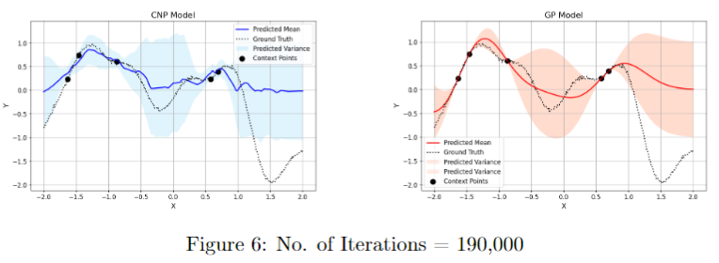
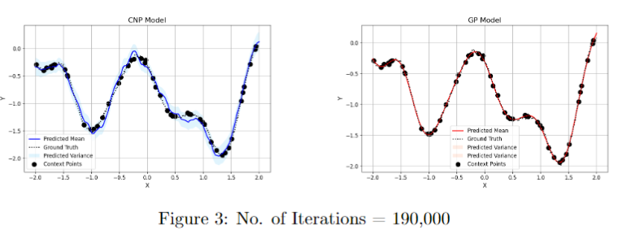
Results
Regression using a single kernel:
5 Context Points
50 Context Points

Slide 8
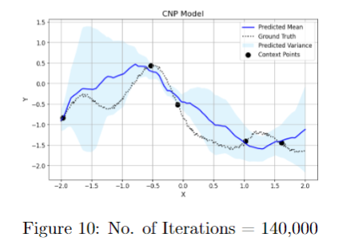
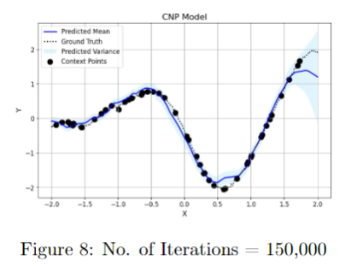
Results
Regression using mixed kernels:
5 Context Points
50 Context Points

Slide 9
Conclusion
Accuracy with Few Data Points:
CNPs are capable of making accurate predictions even when provided with only a small number of training data points, showcasing their ability to generalize well from limited observations.
Flexibility in Modeling:
CNPs exhibit flexibility in modeling complex functions and capturing intricate patterns in the data, allowing for accurate predictions across various settings and scenarios.
Efficient Training and Inference:
CNPs leverage neural networks for training and inference, enabling efficient optimization and scalability for handling large datasets and complex functions.
Generalization and Adaptability:
CNPs demonstrate the capacity to generalize well to unseen data patterns and adapt to different input permutations, making them versatile for a wide range of regression tasks.

Slide 10
Ending Note and Contribution
For testing for image completion task, we tried to test CNP on the MNIST dataset but due to lack of time, we could not modify the code to run on the dataset. There were issues with the dimensions of input data while feeding it to the model.
Contribution:
Aditya Agrawal - Literature Survey of the main paper; Integration of GP generating function in the architecture; Testing of the CNP for the 1-D regression task
Swapnil Kashyap - Literature survey of the main and reference papers; Development of the entire CNP architecture; Attempted to test the image completion task (MNIST)

Slide 11
References
Marta Garnelo, Dan Rosenbaum, Chris J. Maddison, Tiago Ramalho, David Saxton, Murray Shanahan, Yee Whye Teh, Danilo Jimenez Rezende, and SM Eslami. Conditional neural processes. In International Conference on Machine Learning, 2018. URL https://github.com/google-deepmind/neural-processes?tab=readme-ov-file.

